Slide 1

PRAIRIELEARN
Automating Database Question Generation and Marking With
NISHANT
ANDREI
SKYLER
MATTHEW
Notes:
Slides 1 - 6: Andrei
Slides 7 - 10: Skyler
Slides 11 - 14: Nishant
Slides 15 - 18: Matthew
Introduce selves from left to right.

Slide 2
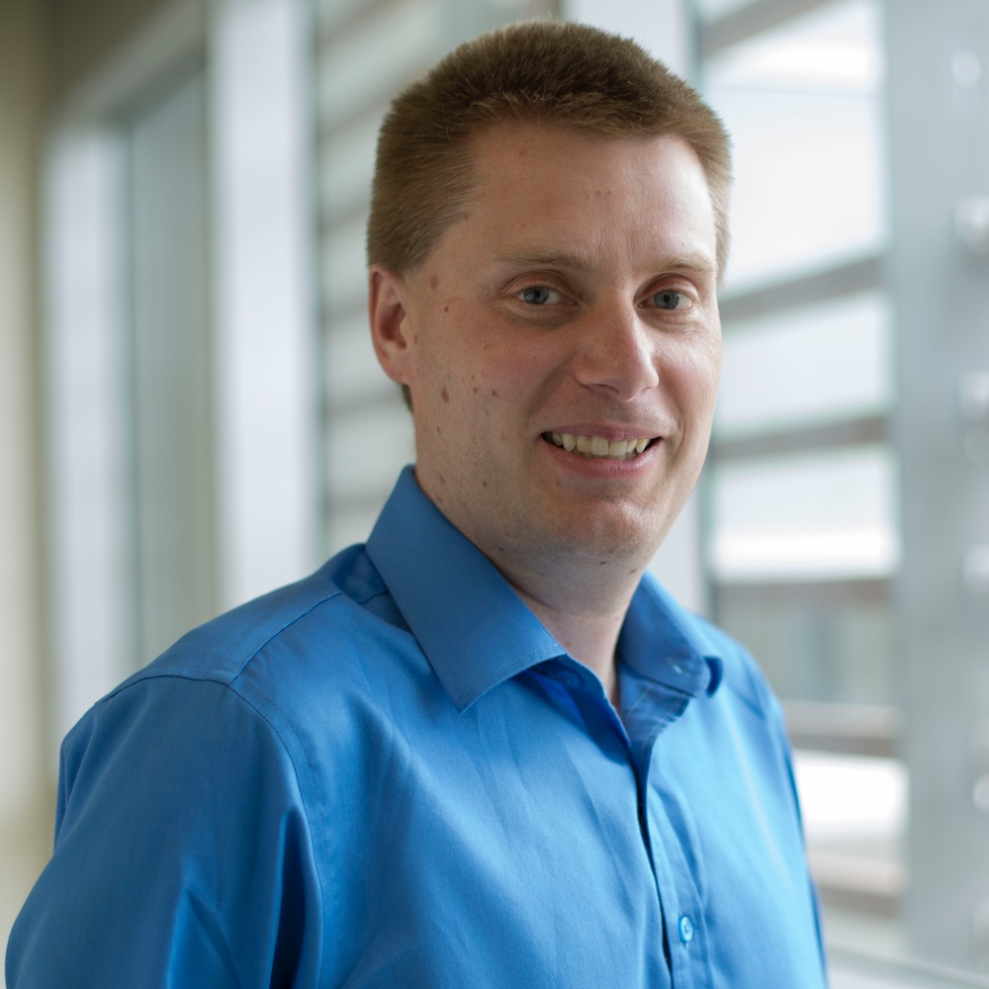
CLIENT
Dr. Ramon Lawrence (PhD)
Professor at UBC-O’s Computer Science Department
COSC 304 Instructor
Plans to use this project starting Fall 2023

Slide 3


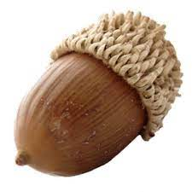

THE
PROBLEM
Students in COSC 304 are reliant on using multiple different platforms for their coursework - including time-sensitive evaluations such as midterms and final examinations.
Notes:
There are all different softwares, the solution is that we need

Slide 4
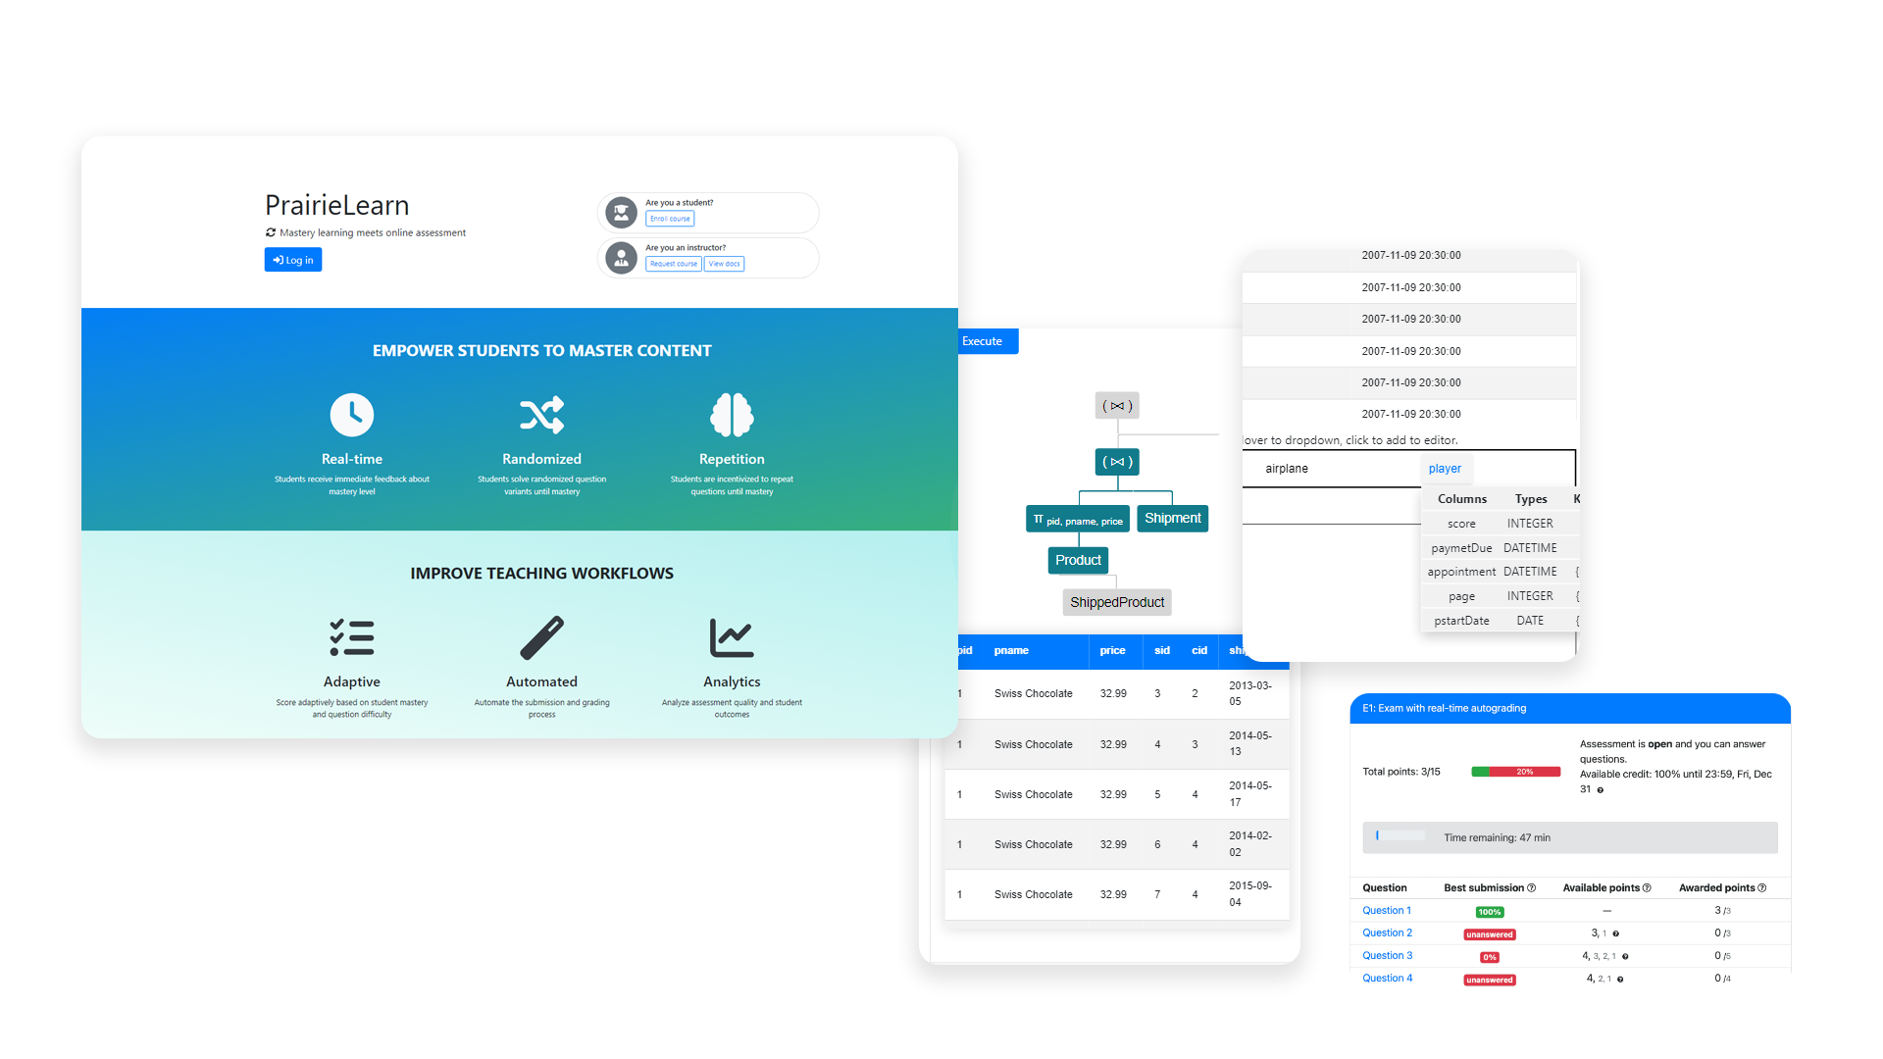
PRAIRIELEARN
Open-source software
Creating and delivering learning experiences and assessments for students.

Slide 5
THE PROJECT
The deliverable will be an instance of PrairieLearn hosted on local servers at UBC Okanagan Campus. The PrairieLearn instance will contain questions from
COSC 304 lab 1 - Relational Algebra
COSC 304 lab 2 - SQL table creation,
and COSC 304 lab 3 – SQL table querying.

Slide 6
REQUIREMENTS
Integrate questions
Integrate RelaX Editor
Integrate SQL Editor
Execute answer prior to submission
Display query results and visualizations
Automate randomized question generation
Automate grading
Stretch: Grading for partial marks

Slide 7


Slide 8
TARGET
AUDIENCE
&
USAGE
Instructors Teaching Assistants Students
Query visualizations and results to experiment and better understand Relational Algebra and SQL Countless question variants and types Instant grading Easy access from anywhere

Slide 9
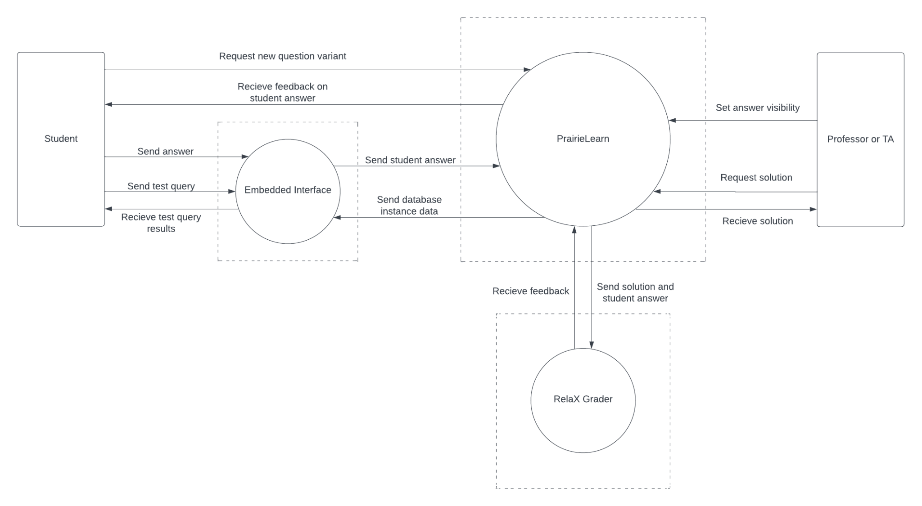

Slide 10
KEY FEATURE:
DATABASE GENERATION AND RANDOMIZATION
Database generation and randomization was not a requirement within the project’s original scope.
Our Tech. Lead went above and beyond to implement it so as to truly maximize the randomness and produce high-quality auto-generated question variants and databases.

Slide 11
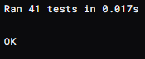
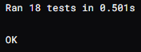
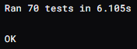
TESTING
Unit: Python’s unittest framework, including parameterized and mock tests
UI & Integration: Selenium WebDriver and Selenium IDE
Stress / Performance: Locust
CI/CD: Drone CI
PrairieLearn itself has 10k+ tests implemented in their system
Unit: 157
UI + Integration: 300
Performance: 26
455 Total Tests
7,299 Lines
34 Test Files

Slide 12
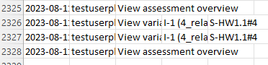
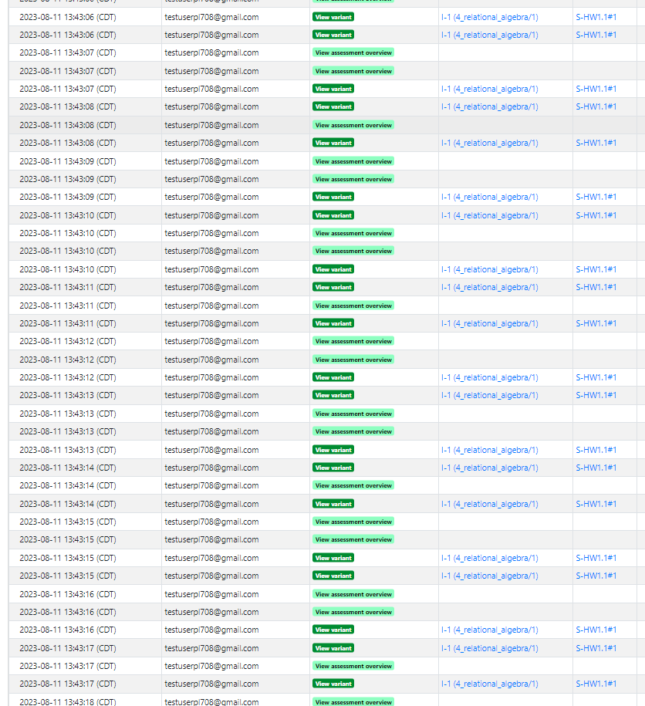

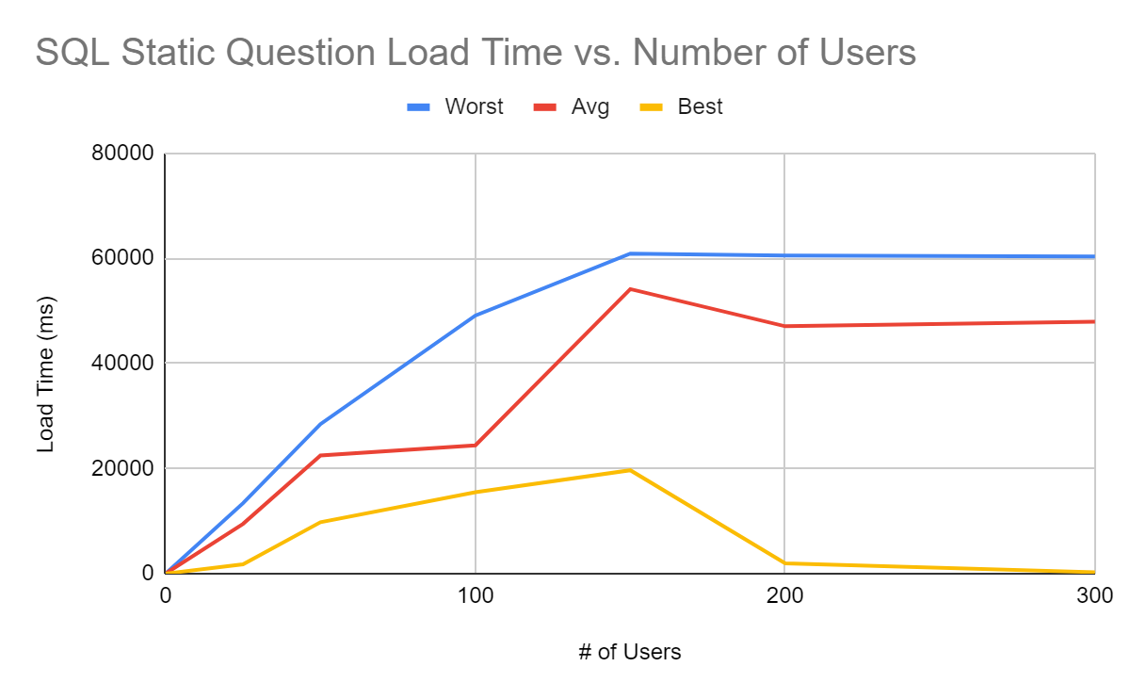
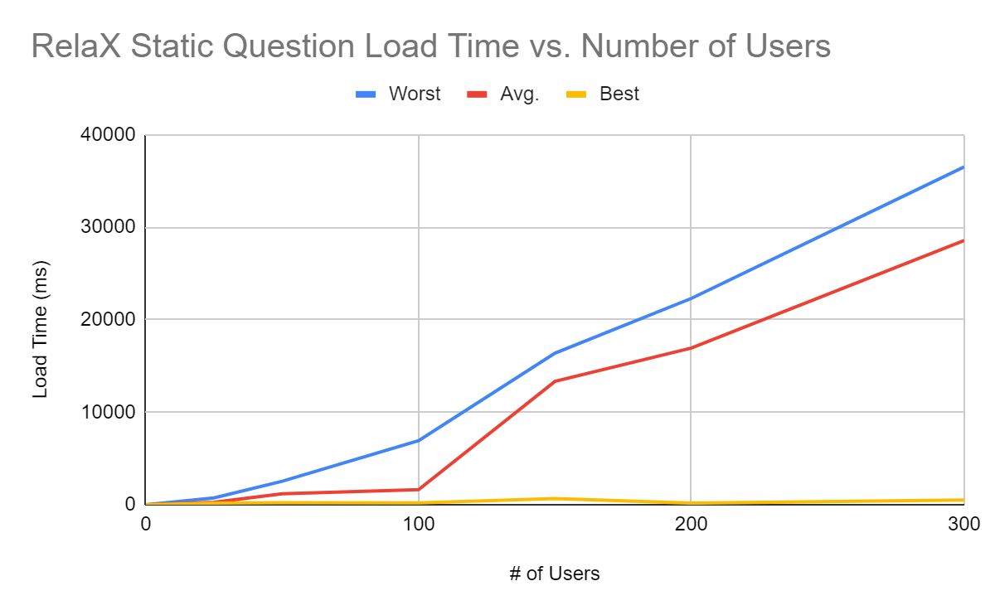
PERFORMANCE
The loading and grading of RelaX have similar performances, and the loading and grading of SQL have similar performances
Relax questions are ~3x faster than the SQL in both areas
SQL Grading follows the same growth rate but takes longer than the loading
Autogenerated questions take ½ the load time as static
The Limit
Around ~500 users is where the servers break
However performance becomes noticeably slow with as little as 25 simultaneous users

Slide 13
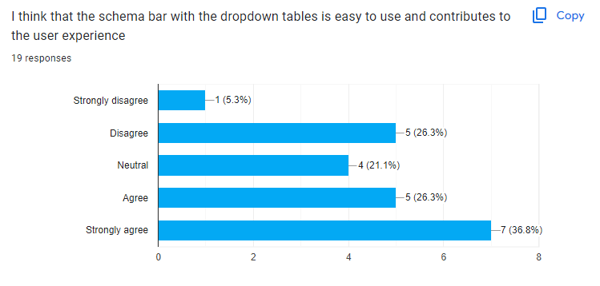
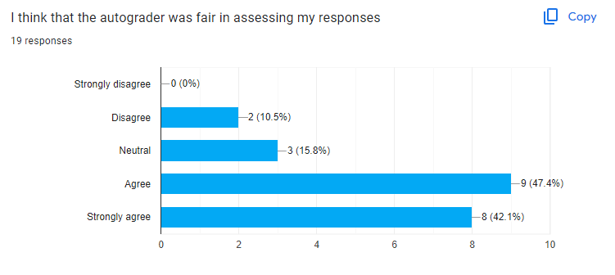
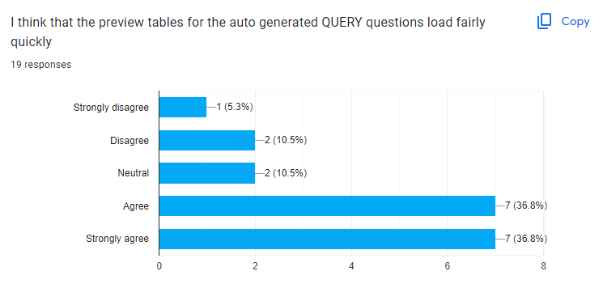
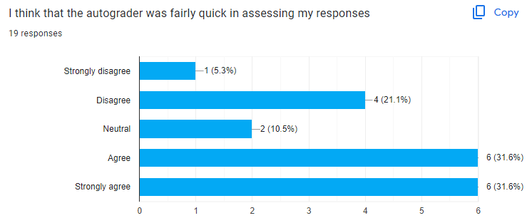
USER TESTING
Takeaways:
Performance - things that interact with a DB on the backend could be faster (Autograder, Expected Output Preview, Execute Results)
Feedback for SQL questions contained negative feedback, ex. Lowest was “Rows: -900%”
DB Schema Bar needs accompanying instructions

Slide 14




WORKFLOW
PM Tools
Dev. Tools
Deployment
Github Projects
Clockify
Visual Studio Code
Docker
Selenium
Locust
Github
Drone
Docker
UBC Servers
Languages
Python Javascript HTML & CSS

Slide 15
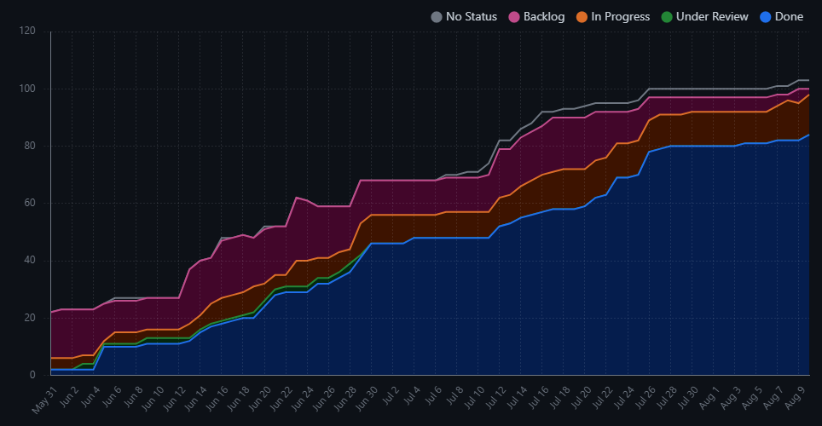
PROJECT STATS
950+ Hours
100+ Cards
130+ Closed PR’s
1300+ Commits
Nishant: 231h
Andrei: 254h
Skyler: 249h Matthew: 225h
Development ended ~ July 30
Testing, deployment, tweaking the grading and fixing bugs since then

Slide 16

Challenges
Docker
Integrating Drone + PrairieLearn
Integrating Drone + Selenium
JQuery and writing JS tests
Question Auto Generation - switching from using server.py files and had to change our approach entirely
Integrating libraries/frameworks into an existing system that we don't have control over
Difficulty debugging specific errors
on Drone and PrairieLearn

Slide 17
Lessons Learned
Not delaying testing until CI/CD setup.
Always pull before merging and resolve merge conflicts in your own branch.
Ensure constant communication and feedback with the client. Your approach may not align with their vision of the product.

Slide 18
SUMMARY & FUTURE WORK
Project documentation can be found on the repo, and has been handed off. Course has been deployed on UBC servers for COSC 304 students to use starting September 2023. Future work on this project could include: - Improving Performance - Using AI/ML to improve on accuracy of automatic grading and automatic generation of questions

Slide 19
Thank You.

